Slide 1
Power BI – Dashboard Instructions

Slide 2
Set 1- Master File Industry Plan

Slide 3
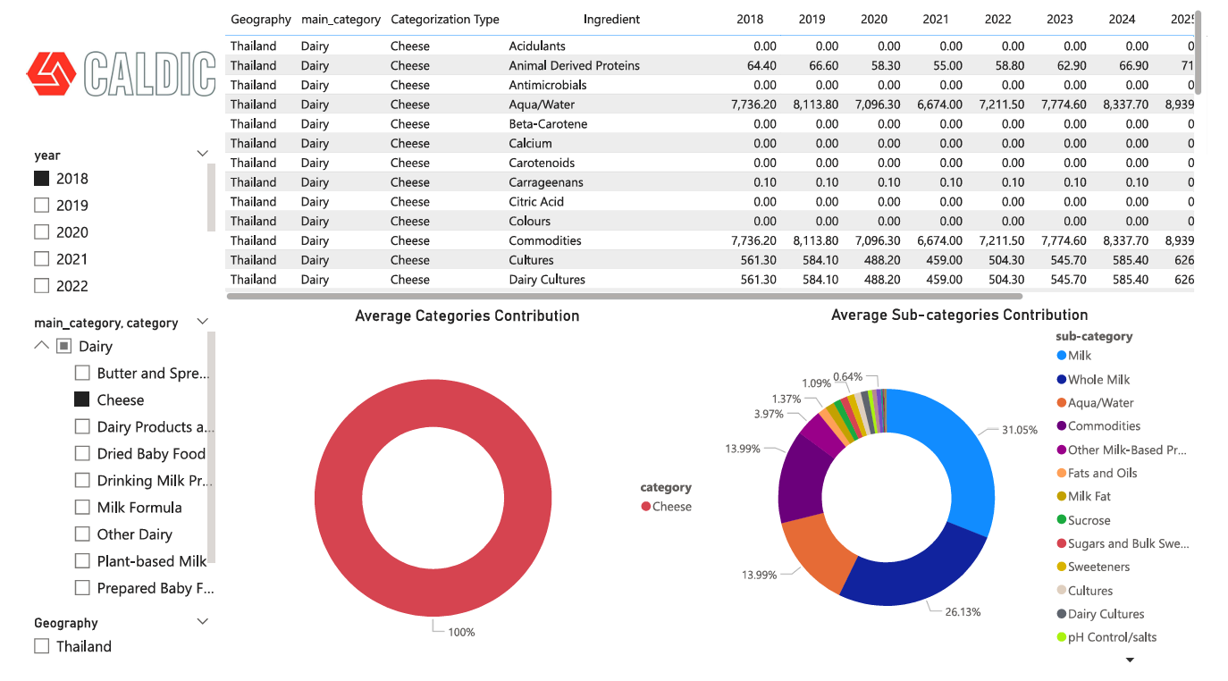
Sheet 1 : Category Analysis
Here you can view the ingredients volume over the years
Select desired year
Select the primary categories or sub-categories to analyze each one's contribution. You can select multiple categories as well. Hold down the Ctrl key while making your selections.
Select desired country
Here you can see the contribution of all main categories (select multiple categories to see the contribution)
This pie chart gives you ingredients contribution for the selected application

Slide 4
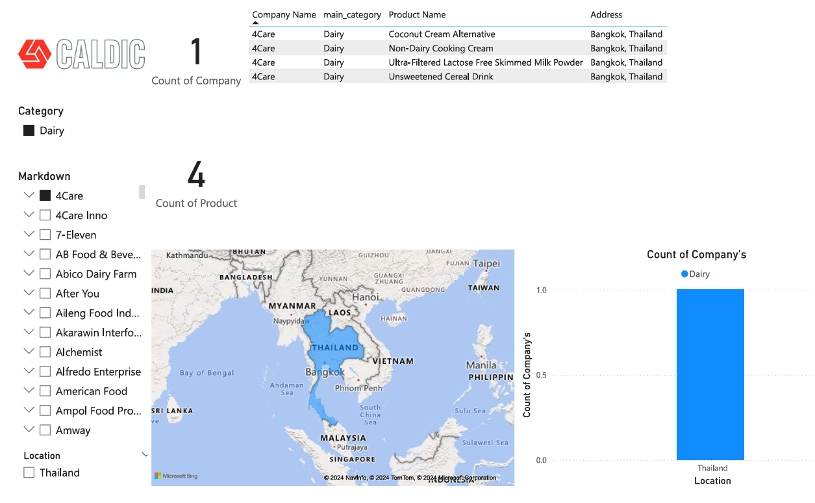
Sheet 2 : Customer Data Analysis
List of products the respective company manufactures
Product count for each selected company
Count of companies selected
Select desired category
List of prospects who deal into the respective categories.
Visual representation of the count of companies by their selected locations
Select desired country
Selected location in world map

Slide 5
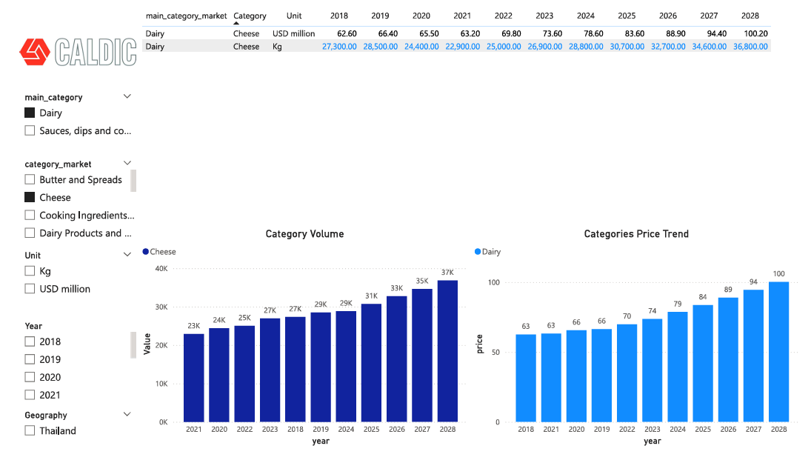
Sheet 3 : Market Size Analysis
Select primary category
This enables us to view the information according to possible criteria. Units, additional categories, and the primary category
Select sub-category/categories to analyze the data
Select for analysis by market size and market volume
Select desired year
Select desired country
Visual representation of the selected categories and their volumes (kg) over the years
Visual representation of the selected categories and their market size (USD) over the years

Slide 6
Set 2- Final Report of Ingredient Analysis

Slide 7
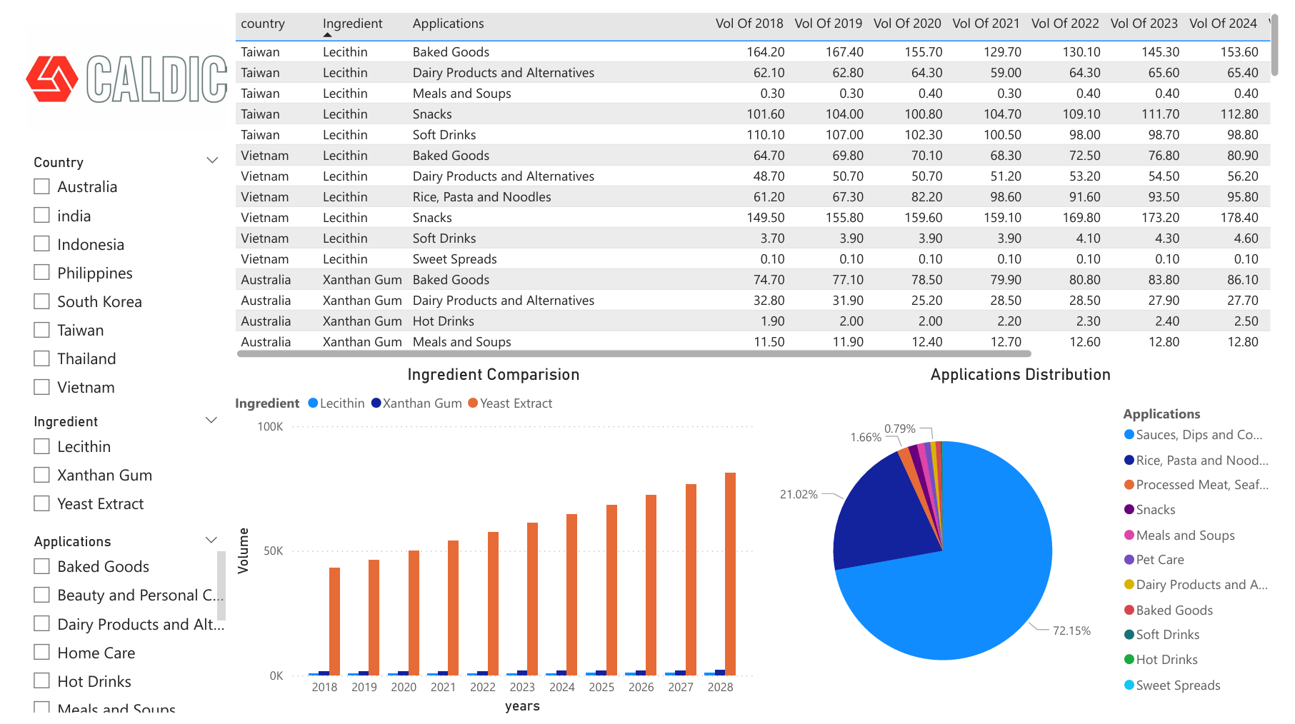
Ingredients Analysis
Select desired country
Ingredients volume over the years
Select ingredient for analysis
(You can select multiple Ingredients as well by pressing Ctrl and Select)
Select any Applications and analyze by different visuals
You may compare the volume of each ingredient over the years
This pie chart gives you ingredients contribution for the selected category

Slide 8
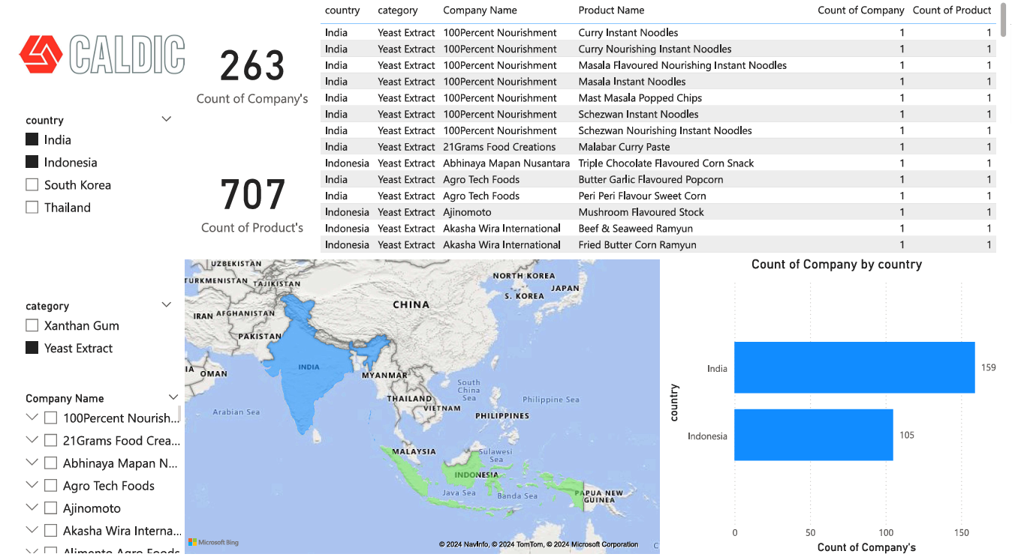
Sheet 2 : Customer Data Analysis
Product count for each company according to the selection
Count of companies by the respective parameters
Select desired country
List of products the respective company manufactures
You can select multiple categories as well by pressing Ctrl and Select
List of prospects who deal into the respective categories.
Selected Location’s In World Map
We can visualize the count of companies by their chosen locations

Slide 9
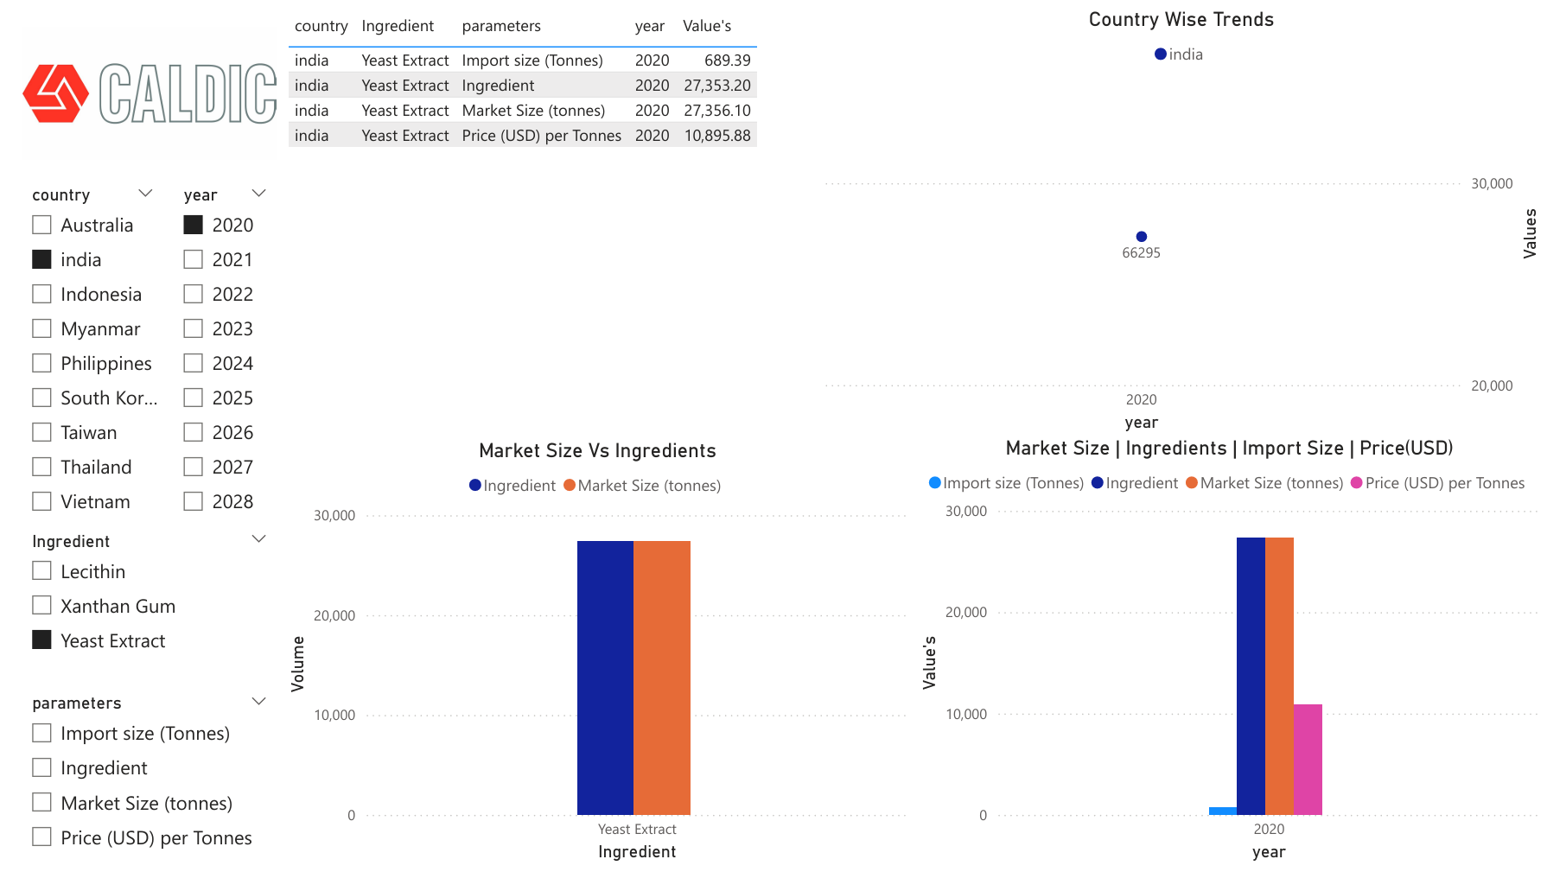
Sheet 3: Market Size Analysis
Here you can view the all the selected data in numbers
We can see the trend of three parameters using a line chart over the years
Select desired year
Select desired country
Select ingredient to see the analysis
Compare or analyze data based on various parameters
Here you can see comparison of market size with ingredient size.
Here you can see comparison of Parameters

Slide 10

Market Overview: Size, Import Data, Price, and Ingredients
Category | country | Market size | Import size | Price(USD) | Ingredient
Lecithin | Myanmar |  | - | -
Lecithin | Taiwan |  | - | -
Lecithin | Xanthan Gum | Vietnam |  | - | -
Xanthan Gum | Australia |  | - | -
Xanthan Gum | India |  | - | -
Xanthan Gum | Philippines |  | - | -
Yeast Extract | India
Yeast Extract | Indonesia |  | - | -
Yeast Extract | Thailand |  | - | -
Yeast Extract | Xanthan Gum | South Korea |  | - | -

Slide 11
Notes
The ingredient by product file has volumes in tonnes, while the industry file has values in kilograms.
To analyze multiple parameters, ingredients, or applications, press Ctrl and select the desired parameters.
For the industry file, we converted tonnes to kilograms by multiplying with 1,000.
In the ingredient by product file, import data and price are currently available for India only; any blank values have been replaced with 0.
In the industry plan file, we only have two parameters: kilograms and price; if a value is not calculable, we've replaced the blank with 0.

